Slide 1

Week 11
EDA Presentation and proposed modeling technique
Data Science Intern at Data Glacier
Project: Bank Marketing (Campaign)
Name: Adrian Baysa
Email: adrianbaysa2@gmail.com
Country: Philippines
Batch Code: LISUM16

Slide 2
Problem Description and Github Repo
Problem Description:
ABC Bank wants to sell its term deposit product to customers and before launching the product they want to develop a model which help them in understanding whether a particular customer will buy their product or not (based on customer's past interaction with bank or other Financial Institution).
Github Repo: https://github.com/agbaysa/dataglacier_week11

Slide 3
EDA for Business Users - Overview
The following approach is done for Exploratory Data Analysis:
First, a Random Forest Classifier is used to determine the feature importance
pandas-profiling is again used on the processed data to identify skewness, cardinality, interactions, and correlations
Formulate hypotheses based on the top features and provide key insights using EDA

Slide 4
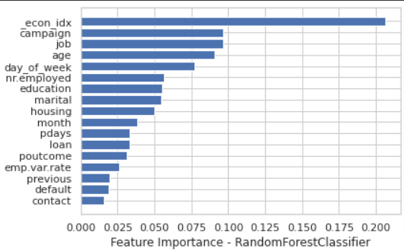
EDA for Business Users – Feature Importance
The top features based on the Random Forest Classifier are as follows:
Economic Index (factor of Consumer Price Index, Consumer Confidence Index, and Eurobor3m)
Campaign:
job
age
day_of_week
education
marital

Slide 5
EDA for Business Users – Hypotheses
The following hypothesis were derived based on the top features:
The target variable and _econ_idx has a linear relationship
The lower the campaign, the more likely the customer will subscribe to a term deposit
Those with white-collared jobs are more likely to subscribe
Senior customers are more like to subscribe
Clients mostly subscribe on the first day of the week (Monday)
Customers with a higher education are more likely to avail
Married individuals are more likely to avail

Slide 6
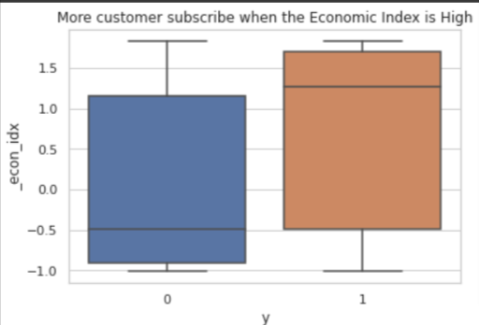
The target variable and _econ_idx has a linear relationship
The Economic Index is the most important feature. The graph shows that clients subscribe to term deposit when the Economic Index is higher (i.e. with an average of above 1.0).

Slide 7
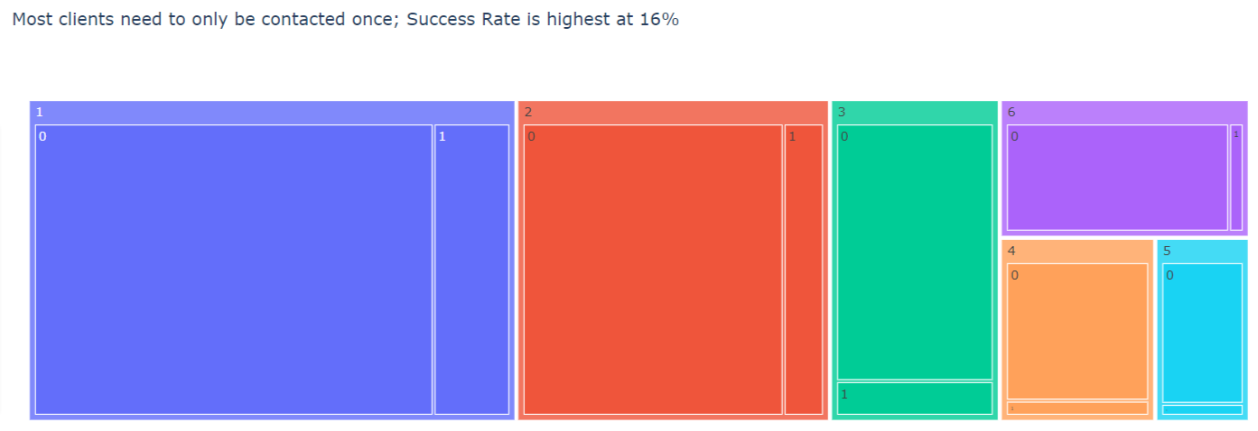
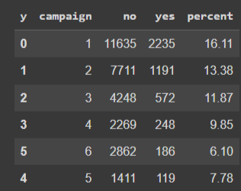
The lower the campaign, the more likely the customer will subscribe to a term deposit
Frequency of calls do not necessarily translate to deposit subscriptions. Those contacted only once has a Success Rate of 16%.

Slide 8
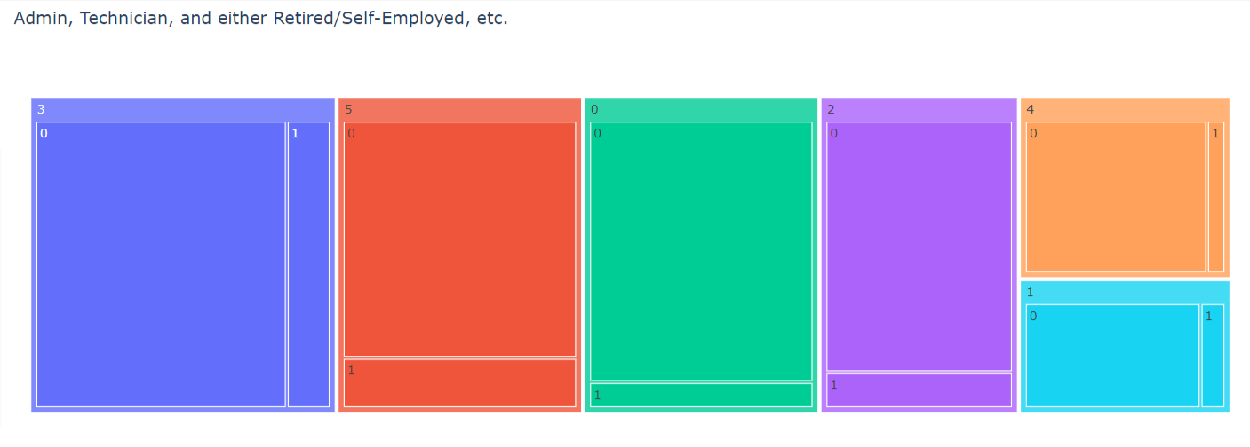
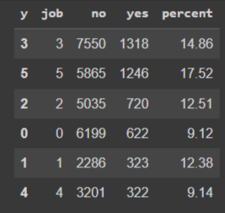
Those with white-collared jobs are more likely to subscribe
Admin, Technicians, and either Retired/Self-employed have higher Success Rates.
where: 'blue-collar': 0, 'management': 1, 'technician': 2, 'admin.': 3, 'services': 4, 'entrepreneur': 5, 'unknown': 5, 'retired': 5, 'self-employed': 5, 'unemployed': 5, 'housemaid': 5, 'student': 5

Slide 9
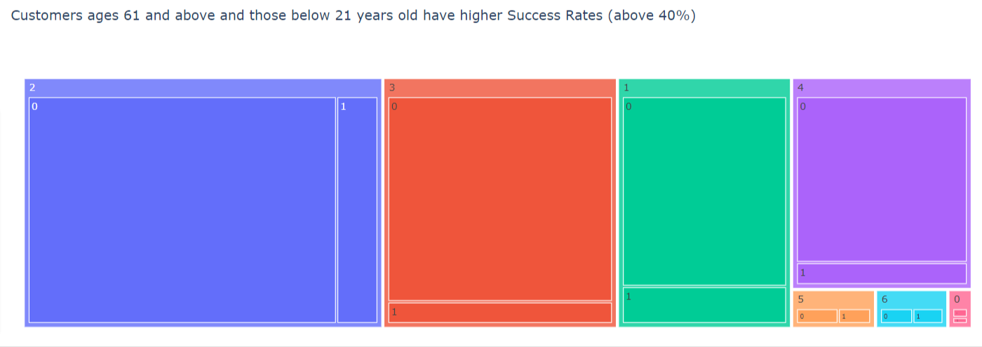
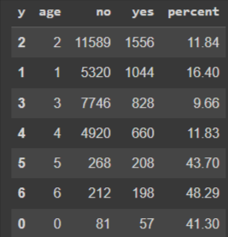
Senior customers are more like to subscribe
Both young and senior customers at the ends of the age spectrum are mostly likely to avail a term deposit with Success Rates that are above 40%
where: 20 and below: 0, 21 to 30: 1, 31 to 40: 2, 41 to 50: 3, 51 to 60: 4, 61 to 70: 5, 71 and above: 6

Slide 10
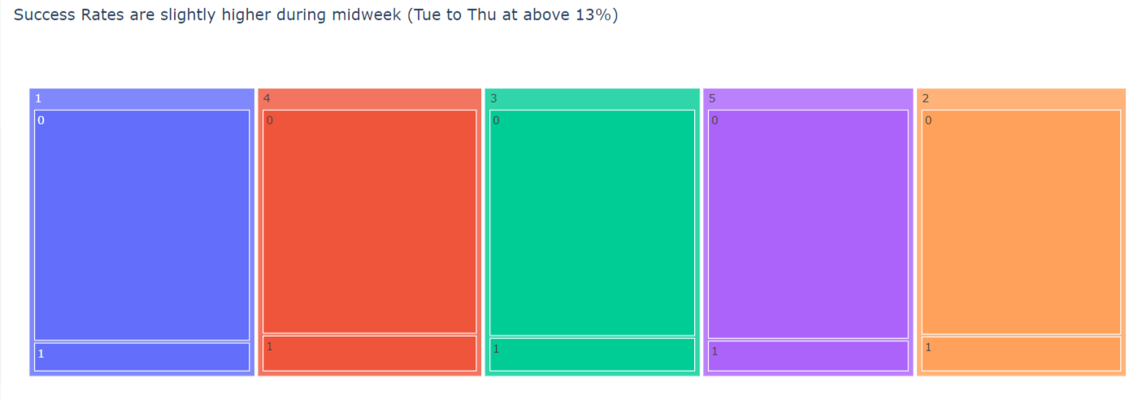
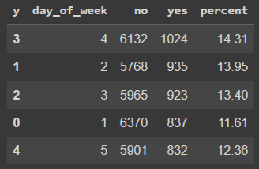
Clients mostly subscribe on the first day of the week (Monday)
The graph shows that deposit subscription rate is higher during the mid week (Tue to Thur) with an average Success Rate of above 13%.
where: Mon: 1, Tue: 2, Wed: 3, Thu: 4, Fri: 5

Slide 11
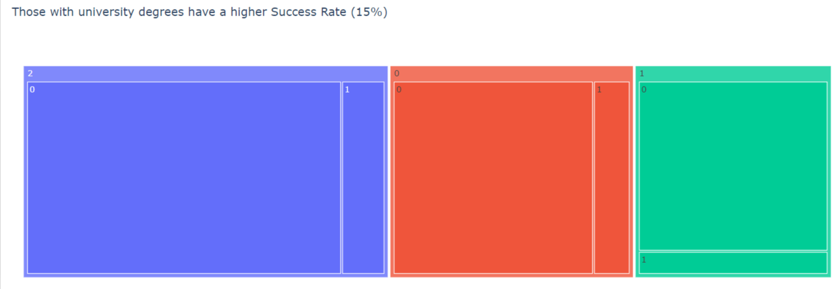
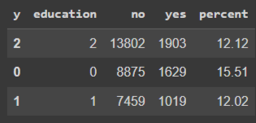
Customers with a higher education are more likely to avail
Those with university degrees have a significantly higher Success Rate of deposit subscription at 14%.
where:'university.degree': 0, 'high.school': 1, 'basic.9y': 2, 'professional.course': 2, 'basic.4y': 2, 'basic.6y': 2, 'unknown': 2, 'illiterate': 2

Slide 12
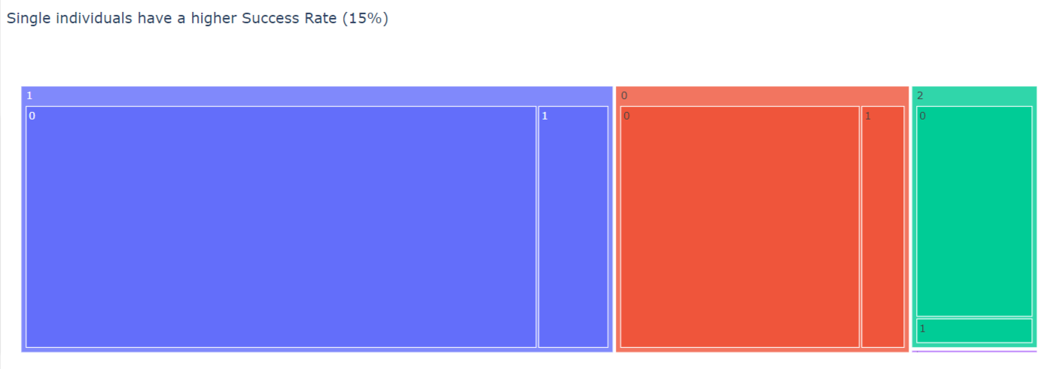
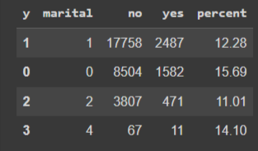
Married individuals are more likely to avail
Single individuals have the highest Success Rate at 14%. Note the 15% Success Rate for customers with unknown marital status.
where:'single': 0, 'married':1, 'divorced':2, 'unknown': 4

Slide 13
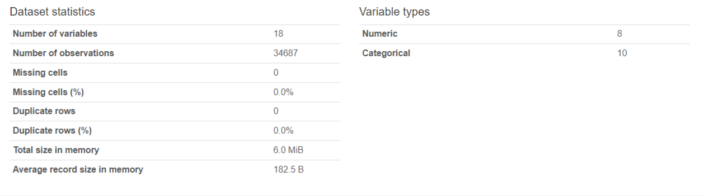
EDA: Data Profiling Highlights

Slide 14
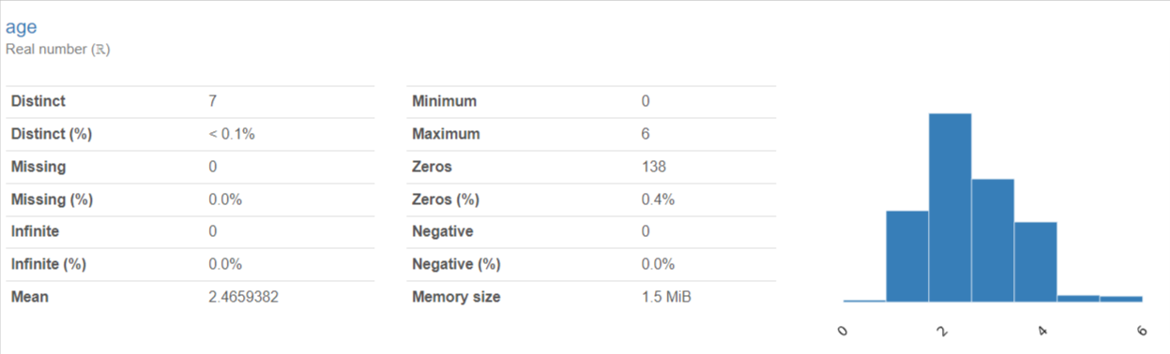
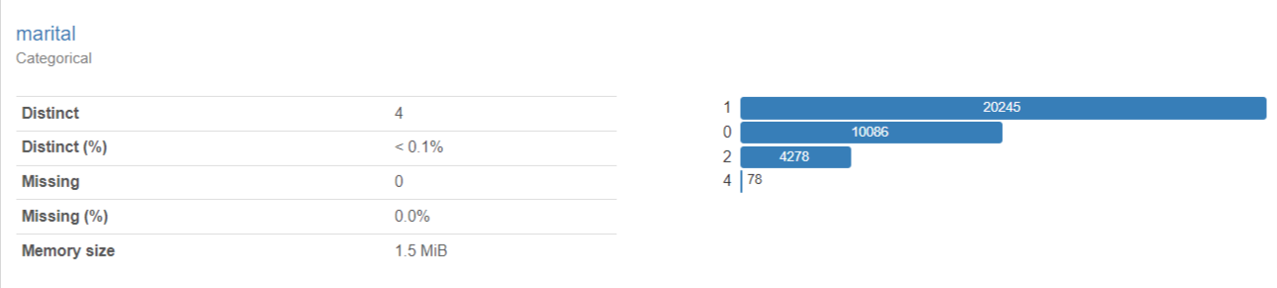
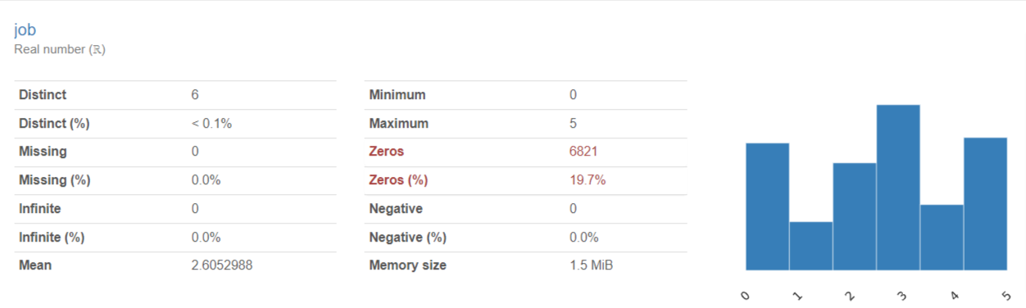
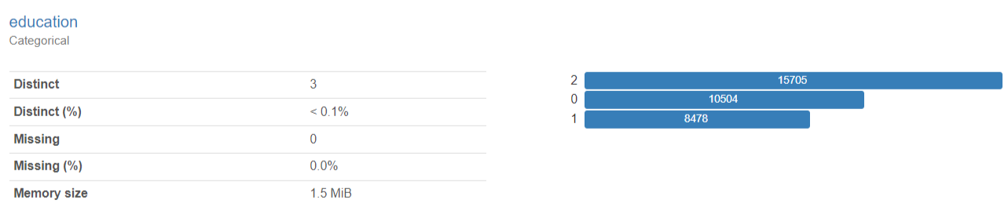
EDA: Data Profiling Highlights

Slide 15
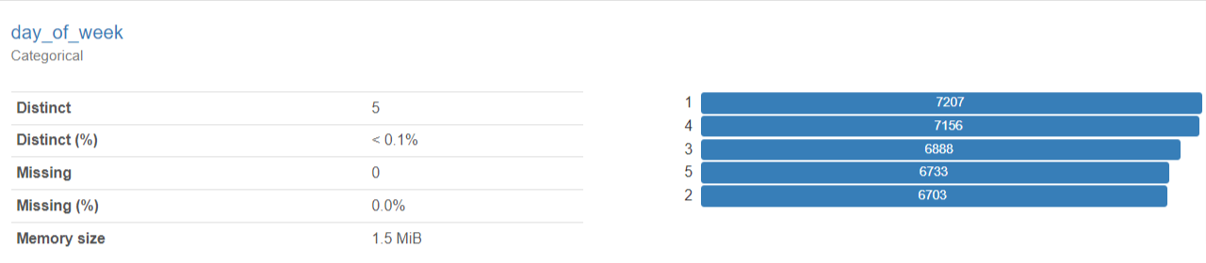
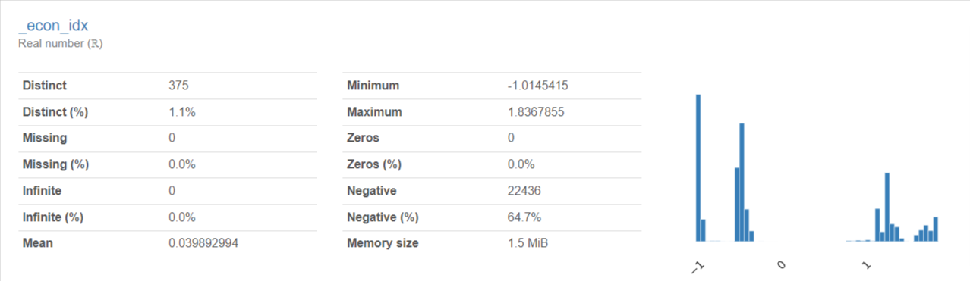
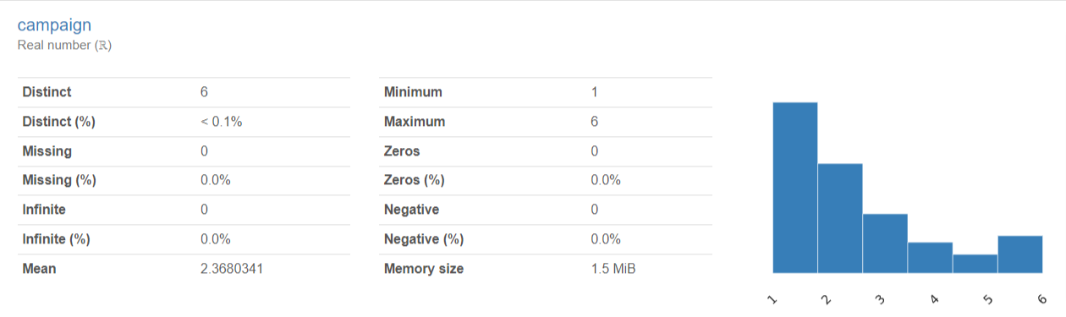
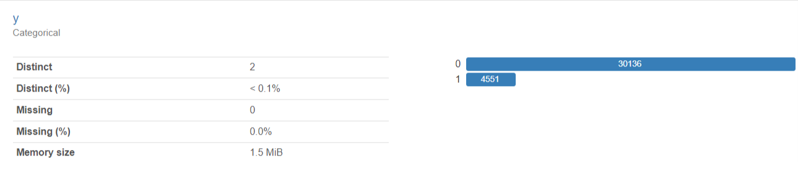
EDA: Data Profiling Highlights

Slide 16
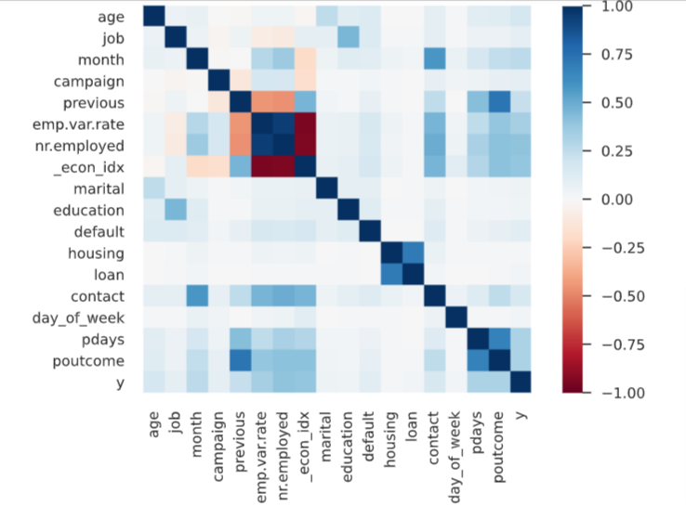
EDA: Correlations

Slide 17
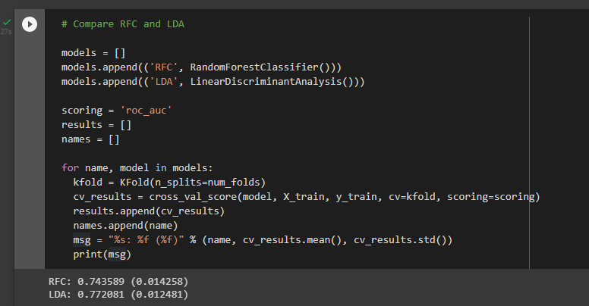
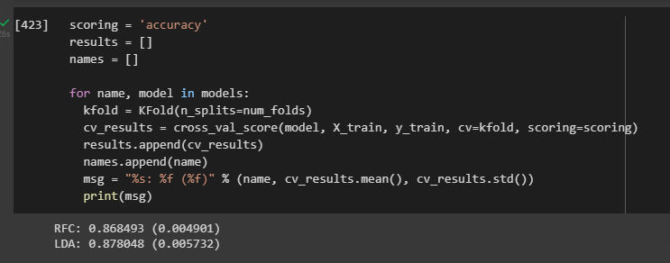
Recommended Model
Comparing Random Forest Classifier and Linear Discriminant Analysis, the latter performed better in terms of ROC-AUC and Accuracy based on cross-validation results. LDA has an ROC-AUC of 0.7720 and
and an accurate of 0.8780.

Slide 18
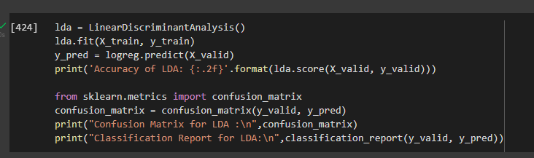
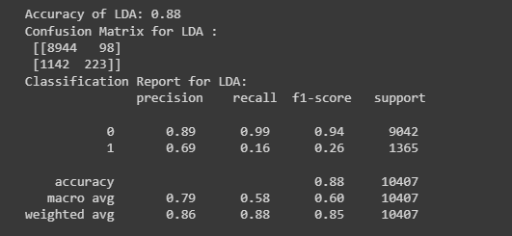
Recommended Model
Based on the Confusion Matrix, several items are highlighted below:
We have correctly identified clients who will surely avail of the term deposit (i.e. low hanging fruit) consisting of 223 customers. These accounts should be prioritized.
We have also correctly identified 8,944 customers who will surely be unlikely to avail of the subscription (i.e. poison fruit). These accounts should be avoided.
For those not identified by the model, the campaign should focus on the demographics that were highlighted.

Slide 19
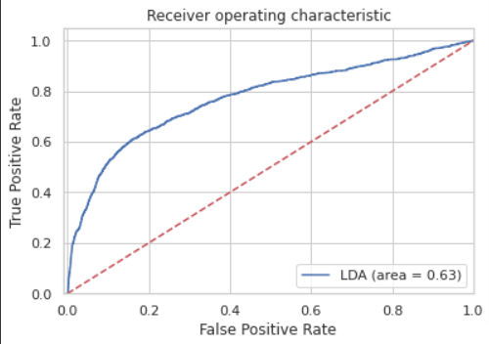
Recommended Model

Slide 20
Business Recommendations
Leverage on the LDA Model
Run the LDA model in order to determine the customers most likely to avail of the deposit (223 customers or 2% of the total). These clients should be prioritized in terms of the campaign. Impact: Translates to cheaper cost of acquisition due to the high probability of deposit subscription.
Actions for Identified Fence-Sitters
For the remaining clients (1,240 or 13%), rules-of-thumb in terms of campaign strategy (e.g. who to reach out first, etc.) can rely on the demographics of the customer in terms of the following:
Similarly, avoid customers that are most likely to not avail of the subscription (8,944 customers or 85% of the total). Impact: Translates to campaign cost saves of 85% as these clients will be deprioritized.
Campaign calls can only be one and not necessarily repetitive.
Priotize those with jobs in Admin Technicians, Retired/Self-Employed
Prioritize clients 20 years old and below and those 61 and above.
Campaigns are more effective on Tuesdays to Thursdays
Prioritize those with University Degrees
Single and Married individuals can be prioritized
Adjust the campaign based on economic conditions. The Economic Index can measure the economic environment (Consumer Price Index * Consumer Confidence Index * Euribor3m). An index of 1.0 and above signifies the likelihood of deposit subscriptions.

Slide 21
Thank You

